Slide 1
First Day Information

Slide 2
Where am I?
PSY 745
Mondays 12:20-2:20
Labs:
M 2:35-4:35
W 12:20-2:20
W 2:35-4:35

Slide 3
Who is this person?
Dr. B
Dr. Buchanan (only if you spell it right)
NOT
Ms or Mrs anything

Slide 4

Who is this person?
http://aggieerin.com or follow the DOOM lab on Twitter @aggieerin

Slide 5

Who is this person?

Slide 6

Who is this person?

Slide 7
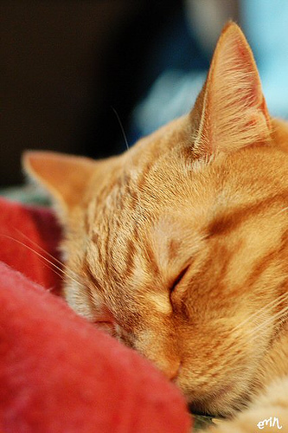
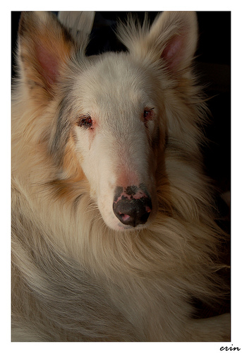
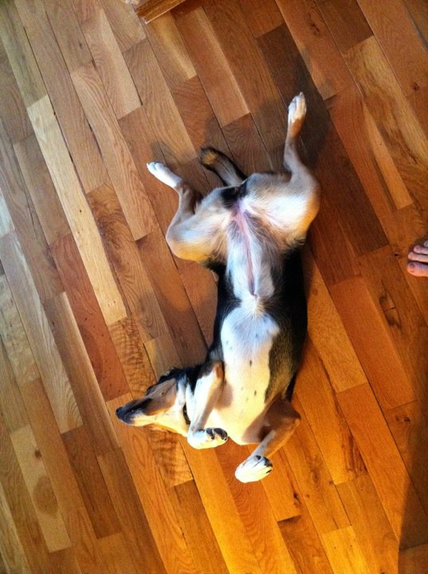
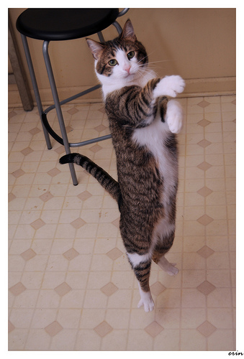
Who is this person?

Slide 8


Who is this person?

Slide 9
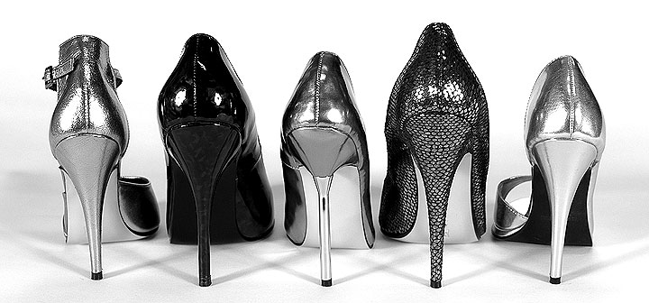
Who is this person?

Slide 10
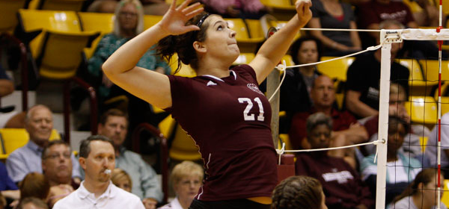
Who is this person?

Slide 11
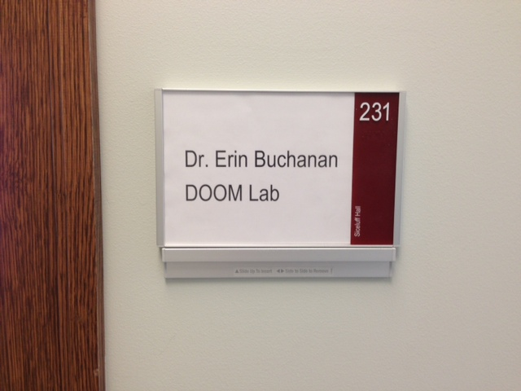
Office
Hill Hall 214D
Middle of the second floor
Siceluff 231

Slide 12
Contact
Office hours:
Tues/Thurs by appointment
Email
erinbuchanan@missouristate.edu

Slide 13
Help Hours
Marshall Beauchamp
Hours:
TBA!
Help Desk Blackboard!

Slide 14
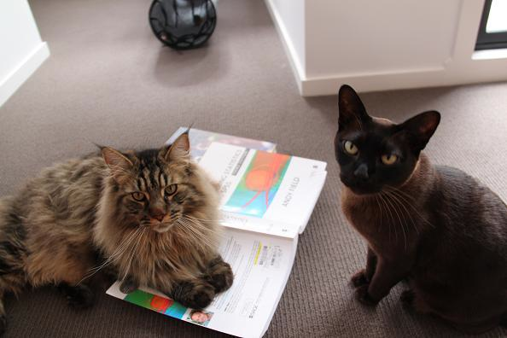
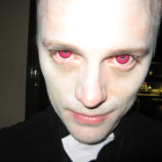
Book

Slide 15
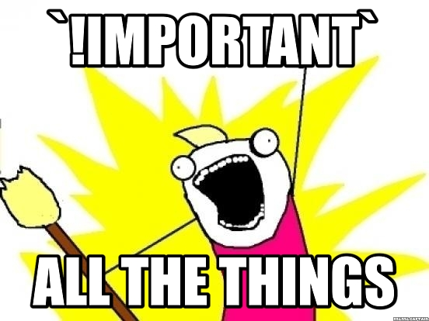
Blackboard
ALL THE THINGS!

Slide 16
Assignments
Practice the stuff we learn in class (25%)
You can work together
You will turn in SPSS junk
You will learn how to write (oh no!)

Slide 17
Exams
Three exams (60%)
Each exam has a take home and in class portion
Stats is cumulative, but the exams are not purposely cumulative.
You must work on these individually.

Slide 18
Labs
Labs! (15%)
We will practice things in class, which you will complete and get credit for.
Note about the labs: do them in lab or get a zero.

Slide 19
Late Policy
Dude, this is graduate school.
Be serious.
Ok, fine 25% off per day.

Slide 20

Make Up Policy

Slide 21

Classroom Policy

Slide 22
Schedule
Look at that schedule!
Isn’t it cute?!
We’ll see if it works!

Slide 23
Now let’s do stuff
Chapter 1

